Slide 1
EIS 2017 IR&D
EIS Axios: Cloud Computing Data Processing
2017
Project Status

Slide 2
ASSETS: Cloud Computing
Project Summary
Project Overview
Technical Approach
With their stated intentions to migrate data processing to cloud computing architectures such as IC-ITE, continued viability with our customers requires that we develop tools and approaches to operate in the cloud environment.
The Cloud Computing Data Processing IRAD will take advantage of components, such as EC2, RDS, EMR, and Lambda, provided by cloud computing services for resource allocation
The goal is to create an engine and a framework that will facilitate the addition and integration of processing modules for data analysis and dissemination
The end product will provide:
  Graphical User Interface to configure the system and to manage components
  All basic implementation to interact with the different components from the cloud provider
  A set of API to quickly develop and integrate custom modules to be used on a system
  An engine that will tie them together
  Incorporation of other processing frameworks such as NiFi
We propose implementing this IRAD on AWS. We think this approach is reasonable because of some important government implementations of IC-ITE, such as C2S and GovCloud, are built on AWS
  Back-End Framework Development
    Complete development of the back-end engine that will allow users to allocate resources to specific EC2 instances and to start/stop based upon task load.
  Front-End GUI Development
    Develop a front-end or GUI to allow users to manage modules as well as to command and control running threads
  NiFi Integration
    Integrate NiFi processing threads into CCDP to provide access to all available processors (on the order of hundreds).
  Other Tools Integration
    Incorporate processing technologies such as Machine Learning and Big Data by adding frameworks to the CCDP engine.
Notes:
07/29/17

Slide 3
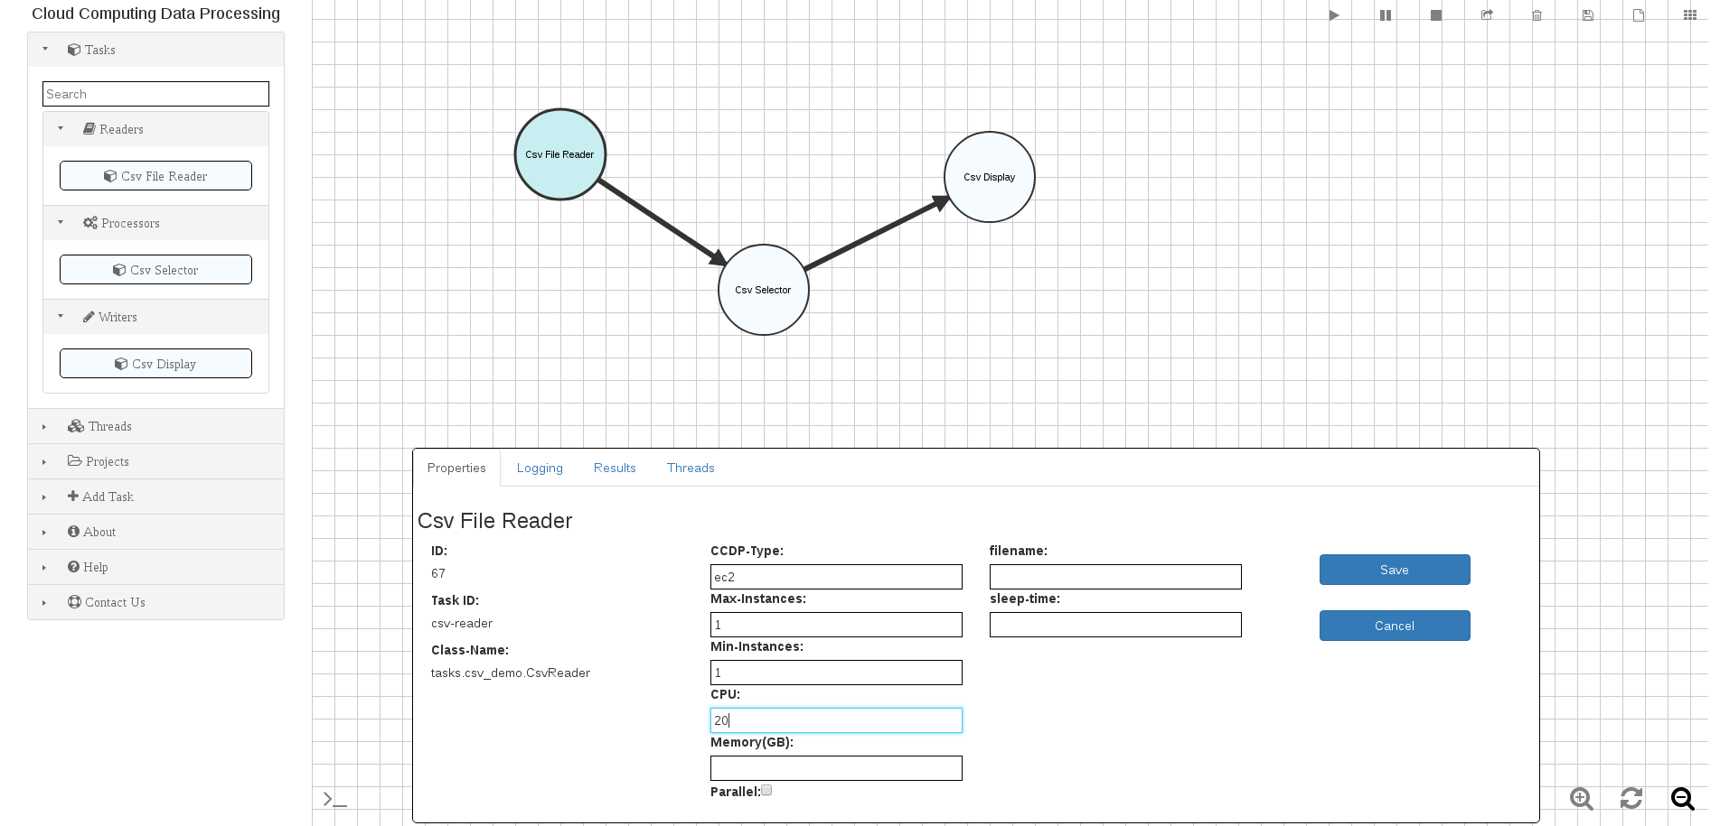
ASSETS: Cloud Computing
Background Information: Graphical User Interface

Slide 4
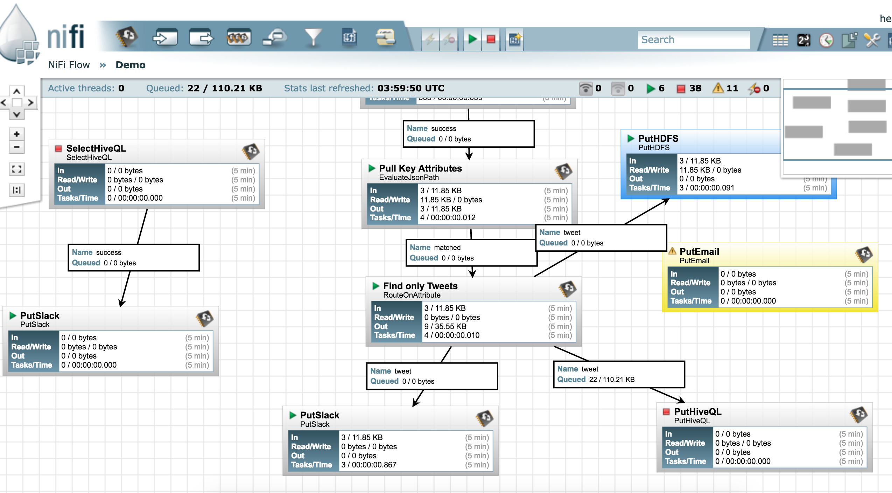
ASSETS: Cloud Computing
Background Information: NiFi Graphical User Interface

Slide 5
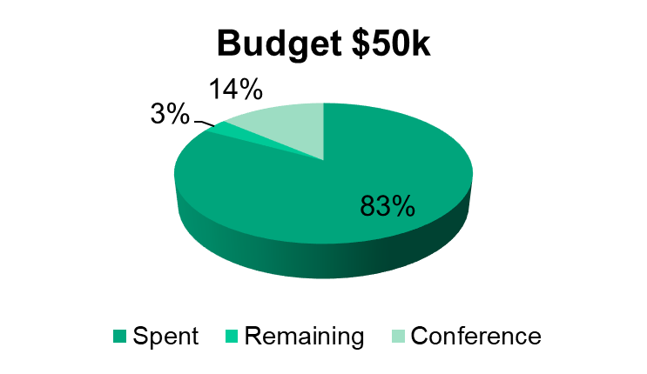
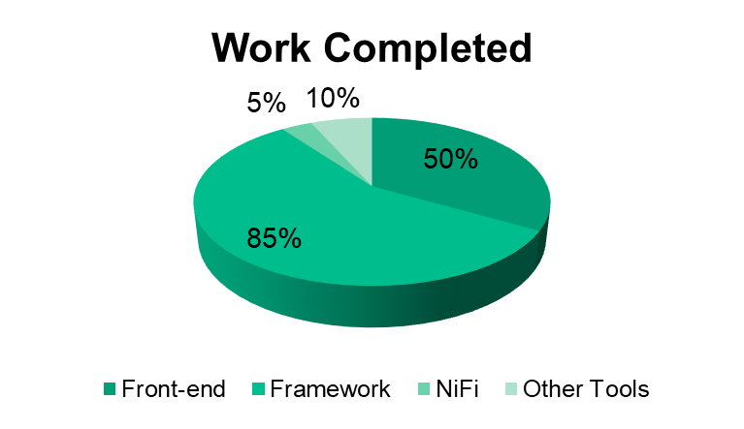
ASSETS: Cloud Computing
Status
Accomplishements
  Back-End Framework Development
    Continue testing and improvements based on feedbacks from current projects running the framework.
    Develop a more generic framework that does not require Mesos.
    Implement additional interfaces to modify engine behavior
    CCDP successfully deployed and use in 7 Hills
  Front-End GUI Development
    Added a front-end login page to command and control the NiFi Deployment
  NiFi Integration
    CCDP starts a new NiFi processing node after successful login.
    More nodes are added to the session cluster as needed
    All NiFi processing nodes are terminated after user logs out
  Other Tools Integration
    None.
  AWS re-invent 2017
    Registered to attend the AWS conference from 11/26 – 12/2

Slide 6
ASSETS: Cloud Computing
Next Steps
  Add uploading, editing, and removing modules through the GUI
  Enable system administrators to configure the framework through the web
  Continue NiFi integration into the framework
    Load balancing
    Improvement on the way we handle session clusters
  Continue incorporating additional big data processing into the framework
  Continue the framework testing and development
  Explore possible uses inside and outside LGS

Slide 7

ASSETS: Cloud Computing
NiFi Integration Demo

